Slide 1
What you need to know to prevent and treat it
Notes:
Thank you for joining this session to learn more about kidney disease. I am a Kidney Health Coach, certified by the American Kidney Fund. I took an online training course that certified me to teach this material today.
[Introduce yourself. Talk about your background, and why you became a Kidney Health Coach.]
I want to learn more about you. Raise your hand if you know someone with kidney disease. Raise your hand if you know someone with diabetes, or high blood pressure.

Slide 2
Today we will discuss
What are kidneys and what do they do?
What is chronic kidney disease (CKD)?
Ways to prevent CKD and kidney failure
Treatments for kidney failure
Notes:
This session will last about an hour. Here’s what we will discuss:
What are kidneys and what do they do?
What is chronic kidney disease, also called CKD?
Ways to prevent CKD and kidney failure
Treatments for kidney failure

Slide 3
1
What are kidneys and what do they do?
Notes:
Let’s get started with what the kidneys are and what they do.

Slide 4
What are kidneys?
2 bean-shaped organs located in your lower back
Your kidneys are vital organs - you need at least 1 healthy kidney to live
Notes:
We will begin with the basics of kidney disease. What are the kidneys?
The kidneys are 2 bean shaped organs, about the size of a fist, located near the lower middle part of your back on either side of your spine. Your kidneys are vital organs. This means you need at least one healthy kidney to live. They are as critical to life as your heart, lungs, and other organs.
Most people have 2 kidneys, but some are born with just one. It is possible to live with just one kidney.

Slide 5
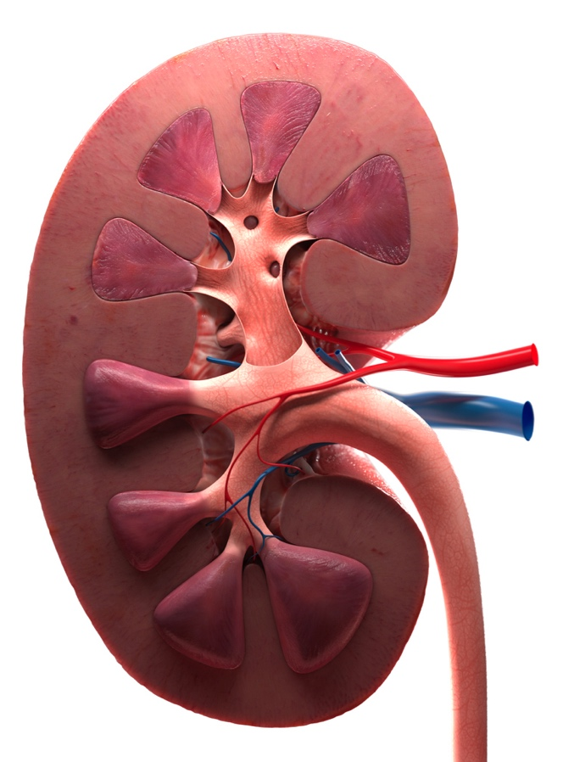
What do your kidneys do?
Filter waste and remove extra fluid out of the blood to make urine
They also help:
Keep bones healthy
Make red blood cells
Control blood pressure
Keep the right amount of minerals in your body
Notes:
The main job of your kidneys is to filter waste and extra fluid out of your blood. You may not realize it, but your body makes waste all the time. The waste comes from food you eat and from using your muscles.
The kidneys have other important jobs that keep your body working the way it should. Your kidneys also help:
Keep your bones healthy and strong
Make red blood cells
Control blood pressure
And, keep the right amount of minerals in your body. Minerals include salt, potassium, and calcium, which you get from food.

Slide 6
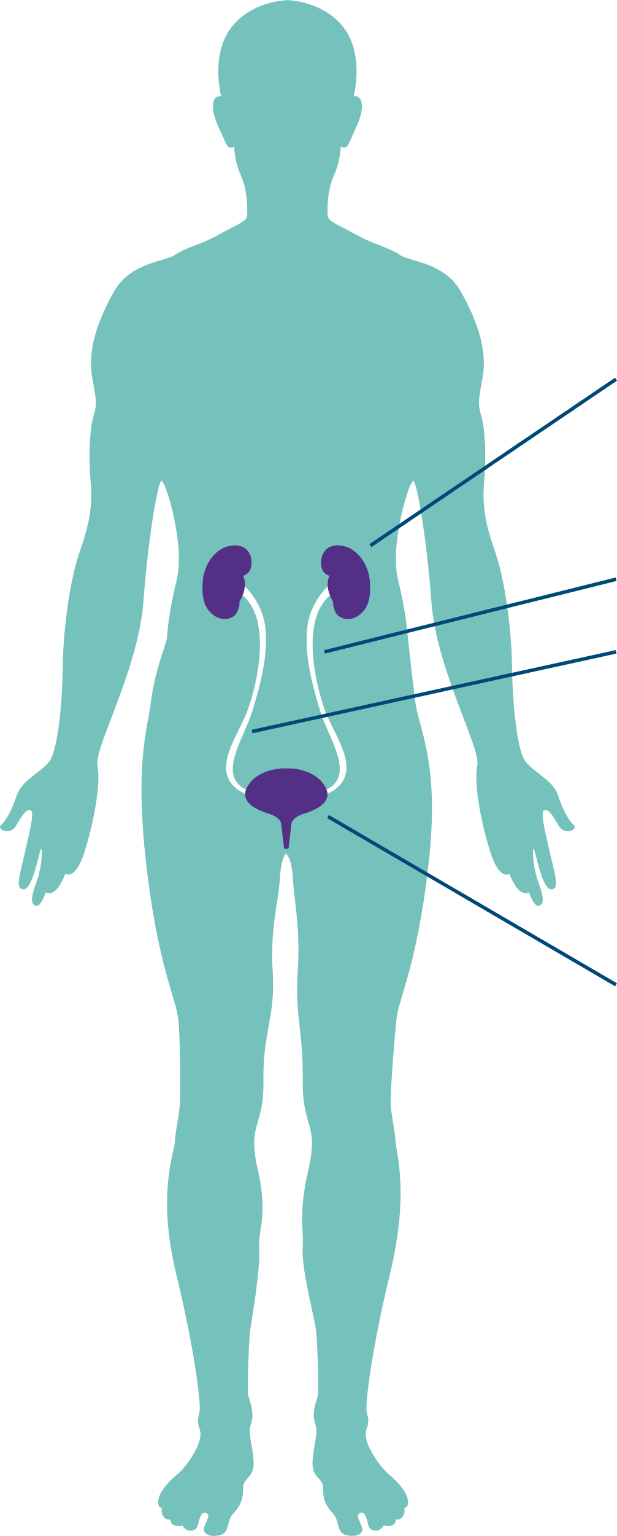
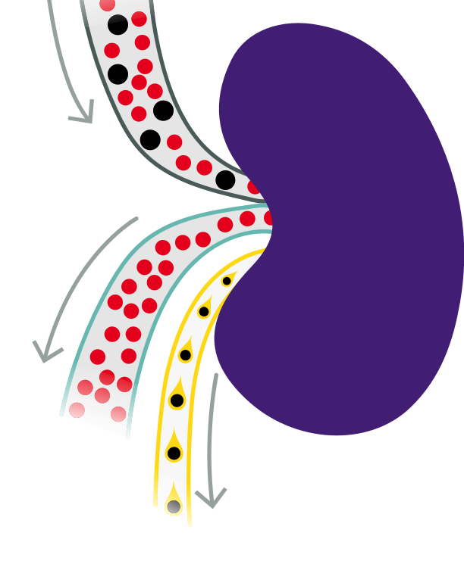
How kidneys work
Your kidneys filter waste and extra fluid to make urine (pee)
Urine flows from your kidneys to your bladder through 2 thin tubes called ureters
Blood enters kidneys
1
Kidneys
Ureters
Bladder
2
3
Clean blood flows back through
the body
Waste and extra fluid leaves kidneys in urine
Notes:
Here’s how your kidneys work:
Blood enters your kidneys
Your kidneys filter waste and extra fluid from your blood to make urine (pee)
The clean, filtered blood leaves your kidneys and flows back into the rest of your body
The urine flows from your kidneys to your bladder through 2 thin tubes called ureters
When you urinate, the waste leaves your body

Slide 7
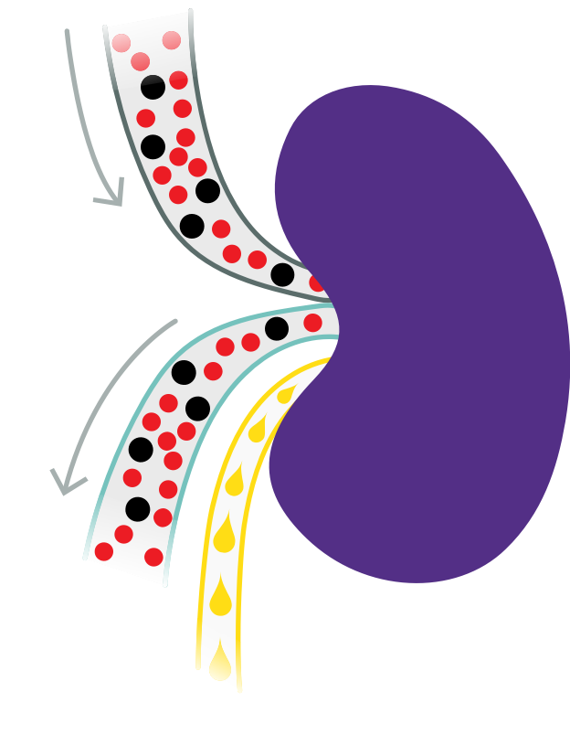
What happens when kidneys are damaged?
Damage to your kidneys keeps them from working as well as they should
This means waste and extra fluids stay in your body and can build up
Blood enters the kidneys
Damaged kidneys do not filter waste from the blood as they should
Waste stays in the body instead of being carried out in urine
1
2
3
Notes:
Different health problems or injury can damage your kidneys. If your kidneys are damaged, they will not work as well as they should to filter waste and water from your blood. This causes waste and fluid to build up in the body, which leads to problems with the heart and lungs. It could also lead to bone disease and anemia. Anemia is a low number of red blood cells, which can make you feel tired and weak.
If the damage (even little damage) to your kidneys gets worse and your kidneys are less able to do their job, you have chronic kidney disease.

Slide 8
2
What is chronic kidney disease?
Notes:
Let’s talk more about chronic kidney disease or CKD.

Slide 9
Chronic kidney disease (CKD)
CKD is permanent damage to your kidneys
Damage will not go away and can get worse over time
You may be able to prevent CKD or slow the damage
Notes:
CKD means that the kidneys are damaged. They do not work as they should. CKD is permanent, or lasting, damage to your kidneys. Unfortunately, the damage will not go away and can get worse over time. There is not a medicine or a treatment that can fix damage to the kidneys. However, if you find out you have CKD early and take steps to keep your kidneys healthy, you can prevent or slow the damage from getting worse. Also, there has been an increase in available treatments to prevent CKD from getting worse.

Slide 10





Do you know?
How many adults in the U.S. have CKD?
A
B
C
D
5%
15%
50%
75%
Notes:
Do you know? How many adults in the U.S. have CKD?
[Wait for them to guess, then click to next slide for answer]

Slide 11




Answer
How many adults in the U.S. have CKD?
B
15%
That’s about
1 in 7 adults.
Centers for Disease Control and Prevention (CDC), 2020.
Notes:
The correct answer is 15% of U.S. adults have chronic kidney disease. That is about 1 out of 7 adults
CKD is one of the fastest-rising diseases that can be prevented.
Source: Centers for Disease Control and Prevention (CDC). 2020. Chronic Kidney Disease Basics. Retrieved from https://www.cdc.gov/kidneydisease/basics.html

Slide 12
5 stages of CKD
Stage of CKD | How much damage | How well the kidneys function (work)
Stage 1 | Mild | Normal to slight loss of function
Stage 2 | Mild | Mild loss of function
Stage 3a | Mild to moderate | Mild to medium loss of function
Stage 3b | Moderate to severe | Medium to severe loss of function
Stage 4 | Severe | Severe loss of function
Stage 5 (kidney failure, ESRD/ESKD) | Most severe | Near total or total loss of function
Notes:
The amount of kidney damage ranges from mild to severe damage. There are 5 stages of CKD. Doctors use a blood test to learn what stage of CKD someone has. We will talk more about this test later.
In stages 1 to 2, your kidneys have mild damage. Your kidneys work as well as health kidneys, or just a little less.
Stage 3 is divided into 3a and 3b. In stage 3a, your kidneys have mild to moderate damage. This means your kidneys have mild to medium loss of function. In stage 3b, your kidneys have moderate to severe damage. This means your kidneys have medium to severe loss of function. In these stages, people usually do not have symptoms. Many people will not even know they have CKD.
In stage 4, there is severe damage to your kidneys and your kidneys have a severe loss of function.
The last stage, stage 5 is the most severe damage to your kidneys. It means your kidneys have stopped working well enough to do their job to keep you alive. Stage 5 is also called kidney failure, end-stage renal disease, or ESRD, or end-stage kidney disease, or ESKD.
If caught in early stages, one can slow the progression of CKD.

Slide 13
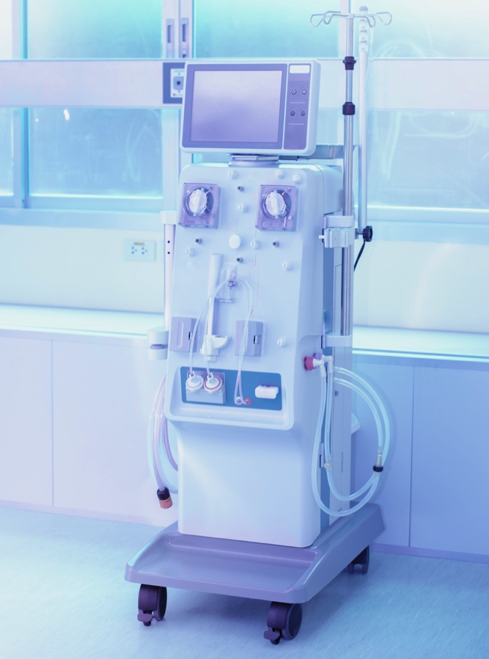
Kidney failure
Also called end-stage renal disease (ESRD) or
end-stage kidney disease (ESKD)
Kidneys stopped working well enough to keep you alive
Need dialysis or a kidney transplant to stay alive and live a good quality life
Notes:
Kidney failure is the last stage of kidney disease. This is why kidney failure is also called end-stage renal disease, or ESRD, or end-stage kidney disease, or ESKD.
Kidney failure happens when the damage is so severe that the kidneys do not work well enough to keep you alive. In other words, the kidneys ‘fail’ to work.
If you have kidney failure, you will need to start dialysis or have a kidney transplant to stay alive and live a good quality life. We will talk more about these later.

Slide 14
Symptoms of CKD
CKD gets worse slowly over time
Most people have no symptoms in early stages (stages 1-3)
You may not have symptoms until your kidneys are badly damaged, such as in stages 4-5
The only way to know if you have CKD, is to get tested!
Notes:
CKD usually gets worse slowly over time. The reason people do not know they have it is symptoms may not appear until the kidneys are badly damaged. For example, most people have no symptoms in stages 1 to 3. By stage 4 some people still do not have obvious symptoms.
The dangerous thing about it is that many people with CKD do not know that they have it until their kidneys are badly damaged. In stage 5, nearing kidney failure, some people may notice symptoms that are caused by waste and extra fluid building up in their body. These symptoms can be severe and are often, but not always, noticeable. These symptoms are what usually bring people into the emergency room. Some people end up in the emergency room with what seems like a serious illness and find out that they have had kidney disease and are close to kidney failure!
The only way to diagnose CKD is to get tested. That’s why it is so important to be tested regularly.

Slide 15









Activity: Symptoms of advanced kidney disease
If your kidneys start to fail, you may have:
Notes:
I want to hear from you! Each icon on the screen represents a symptom a person might have if their kidneys started to fail.
I want you to shout out the symptom that you think each icon represents. Let’s start in the dark blue box in the upper left and work our way across to the right. Then we will go down to the next row.
[For each box, let them guess what the symptom is. Then CLICK to the next slide for answers.]
Answers:
Dry itchy skin
Muscle cramps
Feeling sick to your stomach and throwing up
No feeling hungry
Swelling in your feet and ankles
Urinating more or less often than usual
Trouble catching your breath
Trouble sleeping

Slide 16
Answer: Symptoms of advanced kidney disease
If your kidneys start to fail, you may have:
Dry, itchy skin
Muscle cramps
Feeling sick to your stomach and throwing up
Not feeling hungry
Swelling in your feet and ankles
Decreased urination
Trouble catching your breath
Trouble sleeping
Notes:
Answers:
Dry itchy skin
Muscle cramps
Feeling sick to your stomach and throwing up
Not feeling hungry
Swelling in your feet and ankles
Decreased urine, which means urinating or peeing less
Trouble catching your breath
Trouble sleeping

Slide 17





Other health problems may be a sign you have CKD
Anemia
Gout
Hyperkalemia
Anemia:
Not enough red blood cells in your body, which can make you feel tired
Gout:
A type of arthritis that causes pain and swelling in your joints, usually in the big toe
High potassium (hyperkalemia):
Too much potassium in your blood
Notes:
Other health conditions can be a sign of CKD. This is because when your kidneys aren’t working well, it can cause other problems, such as:
Anemia happens when there are not enough red blood cells in your body. Red blood cells carry oxygen through your body, which gives you energy and helps your muscles, bones, and organs work. Anemia can make you feel weak and tired.
Gout is a type of arthritis that causes pain and swelling in your joints, usually in the big toe. It can be very painful. CKD can cause gout, or gout can cause CKD.
High potassium or hyperkalemia is too much potassium in your blood. Potassium is a mineral and an electrolyte that comes from the food you eat. Your body uses the potassium that it needs, and your kidneys remove any extra. But, when you have kidney disease, your kidneys cannot remove extra potassium, so too much stays in your blood.

Slide 18

If you find out you have CKD early, you may be able to stop kidney damage from getting worse
Damage to your kidneys is usually permanent
It is important to get tested to find CKD early, such as in stages 1-3, especially if you have high blood pressure or diabetes
You can take steps to stop kidney damage from getting worse and keep your kidneys healthy as long as possible
Notes:
If you find out you have CKD early, you may be able to stop kidney damage from getting worse.
Damage to your kidneys is usually permanent and cannot be fixed. But you can slow or stop it. This is why it is important to get tested and find CKD early, such as in stages 1 through 3. It is especially important to get tested if you have high blood pressure or diabetes.
Although you cannot fix damage to your kidneys, when you know you have CKD you can take steps to keep your kidneys as healthy as possible for as long as possible.

Slide 19



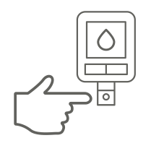
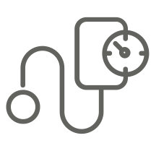




Who can get CKD?
Anyone can get CKD. You may be more likely (at risk) to get CKD if you:
Have diabetes
Have high blood pressure
Have heart disease
Are Black, Hispanic, Native American, or Asian Pacific Islander
Have a family member with kidney disease
Are over 60 years old
Centers for Disease Control and Prevention (CDC), 2020.
Notes:
Anyone can get CKD, but some things can make it more likely to happen to certain people. You may hear a doctor say you are at risk for CKD or have a high risk of CKD, which means you are more likely to get it.
You make be more likely, or at risk, to get CKD if you:
Have diabetes. Diabetes is a disease in which you have too much sugar, also called glucose, in your blood.
Have high blood pressure.
Have heart disease
Have a family member with kidney disease. This is because there are different types of kidney disease and some of them run in families (which means they are genetic), such as polycystic kidney disease (a disease that causes cysts to grow in the kidneys)
Are Black American, Hispanic, Native American or Asian American. Doctors and researchers are not exactly sure why, but it may be because diabetes and high blood pressure are more common in these groups.
If you are over age 60. This is because as you get older, your kidneys naturally do not work as well as when you were younger. Older adults are also more likely to have diabetes and high blood pressure.
Having one of these risk factors does not mean that you will get kidney disease. But if you find and treat kidney disease early, you may be able to prevent it from getting worse. If any of these apply to you, ask your doctor to get tested and how often you should be tested.

Slide 20
Do you know?
What is the #1 cause of CKD?
A
B
C
D
Age
Alcohol
Diabetes
High blood
pressure
Notes:
Do you know? What is the number one cause of CKD?
[Wait for them to guess, then CLICK to the next slide for the answer.]

Slide 21

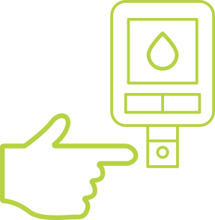
Answer
What is the #1 cause of CKD?
C
Diabetes
50%
Notes:
Diabetes is the leading cause of kidney disease and kidney failure. Almost half, or 50%, of all kidney failure is caused by diabetes.
Source: https://www.kidneyfund.org/prevention/are-you-at-risk/diabetes.html

Slide 22
Diabetes and CKD
Diabetes is a disease in which you have too much sugar (glucose) in your blood
Over time, high blood sugar can damage small blood vessels in your kidneys and cause CKD
Diagnosing diabetes | Fasting blood glucose | A1C test result
Normal | Less than 100 mg/dL | Less than 5.7%
Pre-diabetes | 100-125 mg/dL | 5.7% - 6.4%
Diabetes | 126 mg/dL or higher | 6.5% or higher
American Diabetes Association, 2020.
Notes:
Diabetes is a disease in which you have too much sugar, also called glucose, in your blood. Over time, high blood sugar can damage the small blood vessels in your kidneys and cause CKD.
Think of your blood as tomato juice. It is thin and moves easily. When you have diabetes, too much sugar in your blood makes it thicker—more like ketchup. This makes the blood vessels in your kidneys work harder to filter your blood, which damages them.
To check for diabetes, you need to have a blood glucose test to check the amount of sugar in your blood. You can ask your doctor for this test. Fasting blood glucose is a test of your blood sugar after not eating for at least 8 hours – it is usually done in the morning, after fasting overnight. A normal blood glucose level after fasting is between 70 and 99, in other words, less than 100. If your level is between 100 to 125, you have pre-diabetes, which means you have a high risk of getting diabetes. And if your fasting glucose is 126 or higher, it means you have diabetes.
Your doctor can also do an A1C test to check for diabetes. A1C is a measure of your average blood sugar level over 3 months. A1C test results are reported as a percent. The higher the percent, the higher your blood sugar levels over the past 3 months. A normal A1C test result is less than 5.7%. If your A1C is between 5.7 to 6.4%, it means you have prediabetes or are at risk of getting diabetes. And, if you have an A1C of 6.5% or higher, you have diabetes. Your doctor can also use your A1C to see how well you are controlling diabetes. For adults with diabetes, the goal is A1C that is less than 7%.
Source: American Diabetes Association. 2020. Diagnosis. Retrieved from https://www.diabetes.org/a1c/diagnosis

Slide 23
Do you know?
What is the #2 cause of CKD?
A
B
C
D
Age
Alcohol
Diabetes
High blood
pressure
Notes:
Here’s another question. Do you know? What is the #2 cause of CKD?
[Wait for them to guess, then CLICK for the answer.]

Slide 24
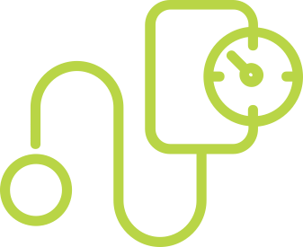
Answer
What is the #2 cause of CKD?
D
High blood
pressure
25%
Notes:
High blood pressure is the second leading cause of kidney disease and kidney failure.
You may have heard the word, “hypertension.” This is just another word for high blood pressure. High blood pressure and hypertension mean the same thing.
High blood pressure causes about 1 in 4, or 25 percent, of all cases of kidney disease.
Source: https://www.kidneyfund.org/prevention/are-you-at-risk/high-blood-pressure.html

Slide 25
High blood pressure and CKD
High blood pressure means your heart is working too hard to pump your blood
Blood flows through your arteries, veins, and blood vessels with too much force or pressure
This can damage the blood vessels in your kidneys and cause CKD
CKD can also cause high blood pressure
Blood pressure stages | Systolic (top number) | Diastolic (bottom number)
Normal | Less than 120 | and | Less than 80
Pre-high | 120-129 | and | Less than 80
High — Stage 1 | 130-139 | or | 80-89
High — Stage 2 | 140 or higher | or | 90 or higher
Centers for Disease Control and Prevention (CDC), 2021.
Notes:
Having high blood pressure means your heart is working too hard to pump your blood. It means your blood flows through your arteries, veins and blood vessels with too much force or pressure. This can damage the blood vessels in your kidneys and cause CKD.
Think of the kidneys as a colander (or strainer). You can imagine water from the sink gently flowing through the colander. This is what it is like when the blood flows through the kidneys when a person has a healthy blood pressure. Now imagine a firehose aimed at a colander. The strong pressure from the firehose would cause damage to the colander over time. This can be compared to the damage high blood pressure causes when blood is flowing too forcefully through the kidneys over time.
CKD can also cause high blood pressure. Remember that kidneys have a role in controlling blood pressure. CKD can cause high blood pressure when damaged kidneys make too much of a hormone that raises blood pressure.
Whenever you get your blood pressure checked, keep in mind that a high reading could be connected to CKD: if you already have CKD, which is causing your high blood pressure, or if your blood pressure is high for another reason, you may be at risk for getting CKD.
It is important to check your blood pressure often. Blood pressure is measured using a cuff that tightens around the upper arm. Your doctor checks each time you visit, and you can also find cuffs at some pharmacies. You can also buy a monitor to use at home!
A healthy blood pressure is considered 120 over 80 or less. High blood pressure is considered 140 over 90 or higher.
Source: Centers for Disease Control and Prevention. 2021. Facts about hypertension. Retrieved from https://www.cdc.gov/bloodpressure/facts.htm

Slide 26


Tests for kidney disease
The only way to know if you have CKD is to get tested.
Urine test
  Checks for protein in the urine
  Helps detect damage to your kidneys
  Having protein in your urine for 3 months or
  more can mean you have CKD
Dipstick urine test
Notes:
The only way to know how well your kidneys are working is to get tested. Kidney tests are important because kidney disease often has no symptoms until your kidneys are badly damaged. This is especially important for people who have diabetes, high blood pressure or a family member with CKD. Fortunately, there are simple, painless tests to check for kidney disease. The combined tests for kidney function are urine test and eGFR.
A urine test uses a sample of urine to look for protein:
When your kidneys are damaged, they may let protein leak through the filters and into your urine. This can be one of the earliest signs of kidney disease.
Protein in the urine can be a sign that your kidneys are not working properly. It helps detect damage to your kidneys.
Having protein in the urine for 3 months or more can mean the kidneys are not working as well as they should.

Slide 27


Tests for kidney disease
Urine test: urine albumin-to-creatinine ratio (UACR)
Uses a microscope to look at urine in a lab
Shows how much of these are in your urine:
Albumin: a type of protein
Creatinine: a waste product in the blood
Urine albumin-to-creatinine ratio (UACR)
UACR result (mg/g) | What it means
Less than 30 | Normal
30 – 300 | High
300 and over | Very high
National Kidney Foundation, 2020.
Notes:
One urine test is the urine albumin-to-creatinine ratio (UACR). This test uses a microscope to look at urine in a lab. It shows how much albumin (a type of protein), and creatinine (a waste product in the blood), are in your urine. Your doctor compares the protein and urine to figure out your UACR.
A normal UACR is less than 30. If your UACR is more than 30mg/g, ask your doctor when you should be tested again.
Source: National Kidney Foundation. 2020. ACR. Retrieved from https://www.kidney.org/kidneydisease/siemens_hcp_acr

Slide 28

Tests for kidney disease
Blood test: eGFR – estimated Glomerular Filtration Rate
Based on your blood test and other factors
Tells how well your kidneys are working
A doctor will look at your eGFR over 3 months to decide if you have kidney disease
The stages of CKD are based eGFR
Notes:
The eGFR is a blood test that tells you how well your kidneys are working to filter waste from your blood. eGFR is short for estimated glomerular filtration rate. Your eGFR is a number based on your blood test for creatinine, which is a waste product in your blood that comes from your muscles. Healthy kidneys take creatinine out of your blood.
Your doctor will figure out your eGFR using a blood test and other factors. Just as with the urine test, doctors look at eGFR over 3 months to decide how well your kidneys are working.
If you have had only one GFR test, you may need to be tested again in a few months. No matter what your eGFR is, ask your doctor when you should be tested again and what other tests you should have.

Slide 29
eGFR results and stages of CKD
Stage of CKD | Ranges of eGFR | How much damage
Stage 1 | 90 or more | Kidney function is almost normal
Stage 2 | 60–89 | Kidney function is slightly less than normal
Stage 3a | 45–59 | Mild to moderate damage to the kidneys
Stage 3b | 30–44 | Moderate to severe damage to the kidneys
Stage 4 | 15–29 | Serious damage to the kidneys
Stage 5 (kidney failure, ESRD/ESKD) | Less than 15 | Kidney failure
Notes:
In most cases, eGFR over 60 is considered a healthy result; 15 to 60 is considered CKD, and below 15 is kidney failure.
In CKD stage 1 or 2, the eGFR may be normal. People living in stage 1 and 2 should live their lives as healthy as possible.
Stage 3a is an eGFR of 45 to 59. Stage 3a CKD means the kidneys have mild to moderate damage and are not working as well as they should. By Stage 3a, you should be seeing a nephrologist (or kidney doctor) to discuss how to prevent the damage from getting worse.
Stage 3b is an eGFR of 30-44. Stage 3b means the kidneys have moderate to severe damage and are not working as well as they should.
Stage 4 CKD is an eGFR between 15 to 29. In stage 4, the kidneys are severely damaged, and are not working as well as they should. At this point, you should be seeing your kidney doctor regularly and following a treatment plan.
Stage 5 is having an eGFR of less than 15 and means the kidneys are failing. Once in kidney failure, you will need to start dialysis or have a kidney transplant.

Slide 30
Know your numbers
Keep track of your numbers. Ask your doctor about these tests and your results. Here’s how often each test should be done:
Test | Who should get it | How often
Blood sugar | People with diabetes | Every day at home
A1C | People with diabetes or CKD | Every 3 months
Blood pressure | People with high blood pressure | Every day at home
eGFR | People at risk of or with CKD | Every 6 to 12 months
Urine test/UACR | People at risk of or with CKD | At least every 12 months
National Kidney Foundation, 2020.
Notes:
It is important to keep track of your numbers. Ask your doctor what tests you need, how often they should be, and what your results mean. In general, here’s how often each test should be done and for who.
Many people are unaware they have diabetes or prediabetes. It would be beneficial to get a yearly test of your A1c.
Source: National Kidney Foundation. 2020. Three simple tests your should ask your doctor to do. Retrieved from https://www.kidney.org/news/kidneyCare/Spring09/askYourDoc_spring09#:~:text=Ask%20your%20doctor%20about%20these,keep%20it%20from%20getting%20worse!

Slide 31

What next steps will you take?
Ask my doctor to test my blood sugar level for diabetes
Check my blood pressure
Ask my doctor to test me for kidney disease
Talk to my doctor about ways to prevent CKD
Notes:
Based on what we have discussed, what next steps will you take?

Slide 32
3
Ways to prevent CKD and kidney failure
Notes:
Now that we have discussed the kidneys and what CKD is, let’s talk about how to prevent it or keep it from getting worse.

Slide 33





It is often possible to prevent CKD or slow it from becoming kidney failure
Control your blood sugar if you have diabetes
Control your blood pressure if you have high blood pressure
Eat healthy
Be active
Notes:
In most cases, it is possible to prevent CKD. The most common causes of kidney disease are diabetes and high blood pressure. Working with your doctor to prevent these problems, or manage them if you have them, can help prevent CKD.
Also, depending on the stage of kidney disease, it may be possible to slow CKD from becoming kidney failure. Although it is unlikely the kidneys will get better, it may be possible to keep the damage from getting worse.
You can take these steps to prevent CKD or kidney failure:
As we discussed before, diabetes and high blood pressure are the 2 leading causes of CKD. So, the best way a person can avoid getting kidney disease is to control their blood sugar if they have diabetes and control their blood pressure if they have high blood pressure.
People can also:
Eat healthy, and
Be active
Let’s talk about each of these.

Slide 34





Ways to manage your diabetes
Take your medicine as your doctor instructed
Check your blood sugar level often and track it. Aim to keep it in a healthy range:
Go to all your doctor visits
Meet with a dietitian who can help you make a healthy eating plan that is right for you
70-130
Less than 180
90-150
Before eating a meal
2 hours after start of a meal
At bedtime
American Diabetes Association, 2020.
Notes:
If you have diabetes, here are steps to manage it:
Take your medicine as your doctor instructed.
Check your blood sugar level often at home with a blood glucose meter and keep track of your levels. Aim to keep your blood sugar level in a healthy range. When you check your blood sugar at home, your level should be:
Between 70-130 before eating a meal
Less than 180, 2 hours after you started to eat a meal
Between 90-150 at bedtime
Go to all your doctor visits. And if you have high blood sugar that will not go down, tell your doctor right away.
Meet with a dietitian who can help you make a healthy eating plan that is right for you.
Low blood sugar can also be concerning. Low blood sugar is below 70. There can be many reasons for this. The most common is a side effect of medicine. Check your blood sugar often and work with your doctor if you have low blood sugar.
Source: American Diabetes Association. 2020. The Big Picture: Checking your blood glucose. Retrieved from https://www.diabetes.org/diabetes/medication-management/blood-glucose-testing-and-control/checking-your-blood-glucose

Slide 35



Ways to control high blood pressure
Take your medicine every day as your doctor instructed
Check your blood pressure at home
Go to all your regular doctor visits
Eat a heart-healthy meal plan, such as:
Limit sodium to 2,300 mg or less a day (1 teaspoon)
Eat healthy fats and lean proteins
Be active and keep a healthy weight
Notes:
If you have high blood pressure, here are steps to control it:
Take your medicine as your doctor instructed.
Check your blood pressure at the same time each day and on the same arm. Keep track of your levels.
Go to all your doctor visits and be honest with your doctor about what you are experiencing.
Eat a heart healthy meal plan such as:
Limit sodium (or salt) to 2,300 mg or less a day, which is about 1 teaspoon
Eat healthy fats and lean proteins
Be active most days of the week and keep a healthy weight. This can help lower blood pressure.

Slide 36







Eat healthy
To prevent CKD, diabetes, and high blood pressure:
        Limit your intake of salt and sugar
        Choose healthy fats
        Eat more fruits, vegetables, and whole grains
        Control portion sizes
Notes:
Eating healthy is a great way to prevent CKD, diabetes, and high blood pressure. To do this:
Limit your intake of salt and sugar
Choose healthy fats
Eat more fruits, vegetables, and whole grains
Control your portion sizes
Let’s talk about each these.

Slide 37


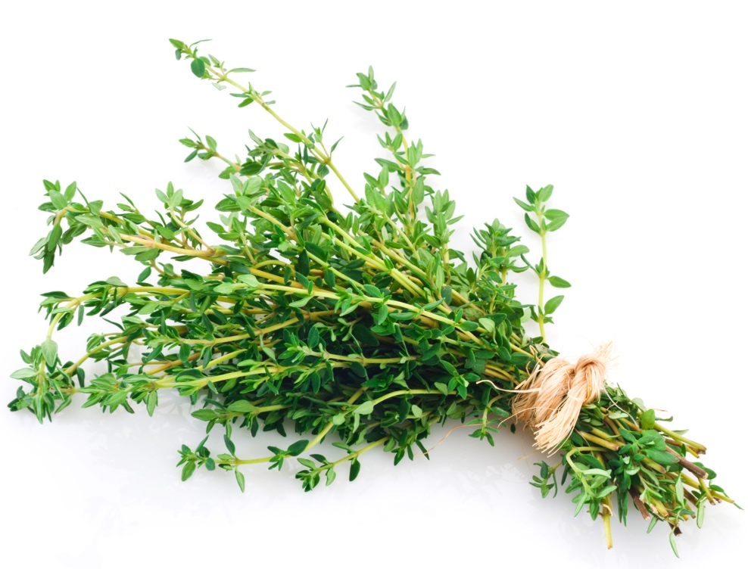
Limit sodium to 2,300 mg or less a day
Limit foods and meals that have added salt, such as frozen dinners, fast food, canned and jarred foods, packaged snacks, processed meats, and bakery items
Eat fresh or frozen vegetables, or choose canned foods that say “no salt added” on the package
Use fresh or dried herbs, lemon juice, or other spices to add flavor to your dishes
Drink water instead of sports drinks or soda
Notes:
Salt is listed on the food label as sodium. Your body needs some salt to keep in balance with water. The amount of salt found naturally in foods is enough to keep a healthy level in your body, but salt is often added to many processed foods, foods we eat in restaurants and even the food we cook ourselves. This can lead to eating too much salt and cause too much salt to build up in your body, which can make your kidneys work harder.
In general, a healthy amount is 2,300mg or less of sodium a day. This is about 1 teaspoon of salt a day. To do this:
Limit foods and meals that have added salt, such as frozen dinners, fast food, canned and jarred foods, packaged snacks, processed meats, and bakery items. These foods are full of added salt.
Eat fresh or frozen vegetables or choose canned foods that say “no salt added” on the package. And if you must have canned, drain and rinse the vegetables under water before serving.
Use fresh or dried herbs, lemon juice, or other spices to add flavor to your dishes.
Drink water instead of sports drinks or soda. Add a few lemon slices or mint sprigs to a large pitcher of water for extra flavor and some variety.

Slide 38
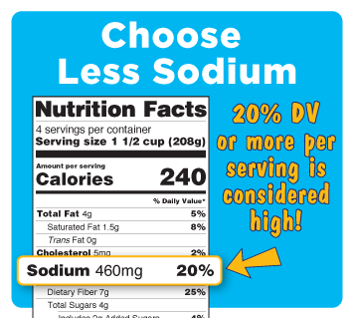
Read the food label for sodium
Low sodium foods have 5% or less Daily Value
High sodium foods have 20% or more Daily Value
Source: FDA, 2021
Notes:
Most of our sodium comes from eating packaged and prepared foods. So, it is important to read the food labels to see how much sodium is in them and choose low sodium foods.
Use % Daily Value as a guide to choose low sodium foods. In general:
Low sodium foods have 5% or less of the Daily Value of sodium per serving
High sodium foods have 20% or more of the Daily Value of sodium per serving
Source: https://www.fda.gov/food/nutrition-education-resources-materials/sodium-your-diet

Slide 39

Limit sugar
Choose foods with natural sugar, like fruit, instead of sweets, such as cookies, cakes, and candies
Avoid processed, packaged foods that have added sugars
Even foods like granola bars, cereals, and yogurts can have high sugar
Avoid sugary drinks like sodas, and sweetened teas or coffee drinks
Limit drinking fruit juices, even those which are “unsweetened”
Notes:
Eating too much sugar can lead to unwanted weight gain and diabetes—the number one cause of kidney disease. Sugar is found naturally in many foods, like fruits. Sugar is also a product made by ‘refining’ or ‘processing’ sugar cane or sugar beets. Processed foods and drinks use refined or processed sugar to sweeten them.
To limit sugar:
Choose foods with natural sugar, like fruit, as a healthy alternative to sweets, such as cookies, cakes and candies. Fruit has natural sugars, which make it sweet.
Avoid processed, packaged foods, in general, like cookies, cakes, muffins. Even foods that are marketed as healthy like granola bars, cereals, and many yogurts can have high sugar content.
Check the nutrition label to see how much sugar is in some of your favorite products, and you may be surprised.
Processed foods are foods that have been pre-prepared in some way and are not in their natural form.
Processed foods make up most of the middle aisles of the grocery store. You will find chips, crackers, cookies, cereal, frozen meals and many more items in this area. Processed foods are often bagged or boxed.
Avoid sugary drinks like sodas, or sweetened teas and coffee drinks.
Though some fruit juices, such as orange juice and grape juice, often do not contain added sugar, limit them because they have lots of natural sugars.
It is okay to indulge from time to time but having too much sugar in your diet can lead to health problems.

Slide 40
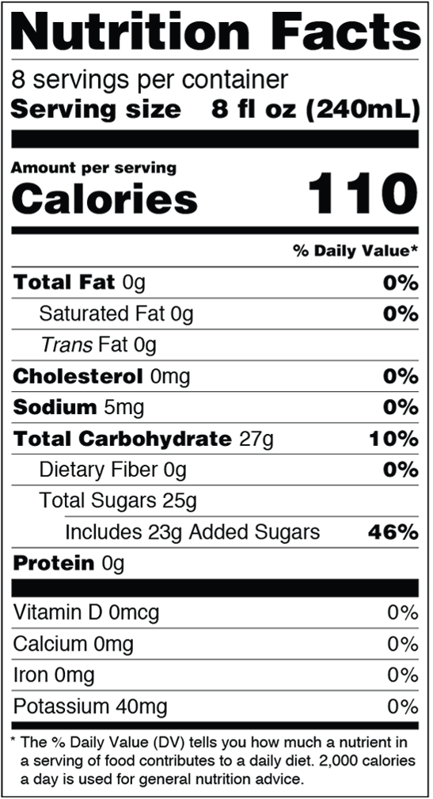

Read food labels for sugar
4 grams (g) of sugar = 1 teaspoon
Low in added sugar is 5% of less Daily Value
High in added sugar is 20% or more Daily value
% Daily Value for added sugar
Source: FDA, 2021
Notes:
You can also read food labels to know how much sugar is in your foods and drinks.
The food label lists Total Sugars and Added Sugars:
Total sugars includes both natural and added sugars. Natural sugars are those that are naturally found in foods, such as in milk and fruit.
Added sugars are added during food processing. Added sugars are from table sugar, syrups and honey; as well as sugar from fruit or vegetable juices.
Keep added sugar as low as possible:
Low in added sugar is 5% or less of Daily Value per serving
High in added sugar is 20% or more of Daily Value per serving

Slide 41

Choose healthy fats
Choose lean meats or fish
Try beans, lentils, or quinoa instead of meat
Learn about the 3 types of fats:
Choose unsaturated fats: liquid at room temperature like olive or canola oil and heart-healthy, like avocados and nuts
Limit saturated fat: solid at room temperature like butter or the skin on chicken
Avoid trans fats: man-made fats, like hydrogenated oil
Notes:
Fat is one of the 3 types of nutrients that give us calories (energy) and we need it to survive. To eat healthy, choose healthy fats. For example, you should choose lean meats, like skinless chicken or turkey, or fish. Choosing lean proteins, which are lower in unhealthy fats, will help keep fat from building up in your blood vessels and protect your heart and kidneys. Or instead of meat as the main dish, substitute with bean, lentils, or quinoa; which are high in protein without the saturated fat. These options are also less expensive. It is also healthier to bake, grill or broil foods instead of frying them.
There are 3 types of fats:
Choose unsaturated fats. They are considered the healthiest and are in foods like nuts, olive oil, and avocados and nuts.
Limit saturated fats, which are solid at room temperature. These can lead to heart disease. Saturated fats are most often found in animal products such as fatty cuts of beef, bacon, and fried chicken. Other foods high in saturated fats are butter, whole milk, margarine, and fried foods.
Avoid trans fats as much as possible. This raises your chance of heart disease, which can cause CKD. Trans fats are mostly found in processed foods like doughnuts, baked goods, pie crusts, and biscuits.

Slide 42

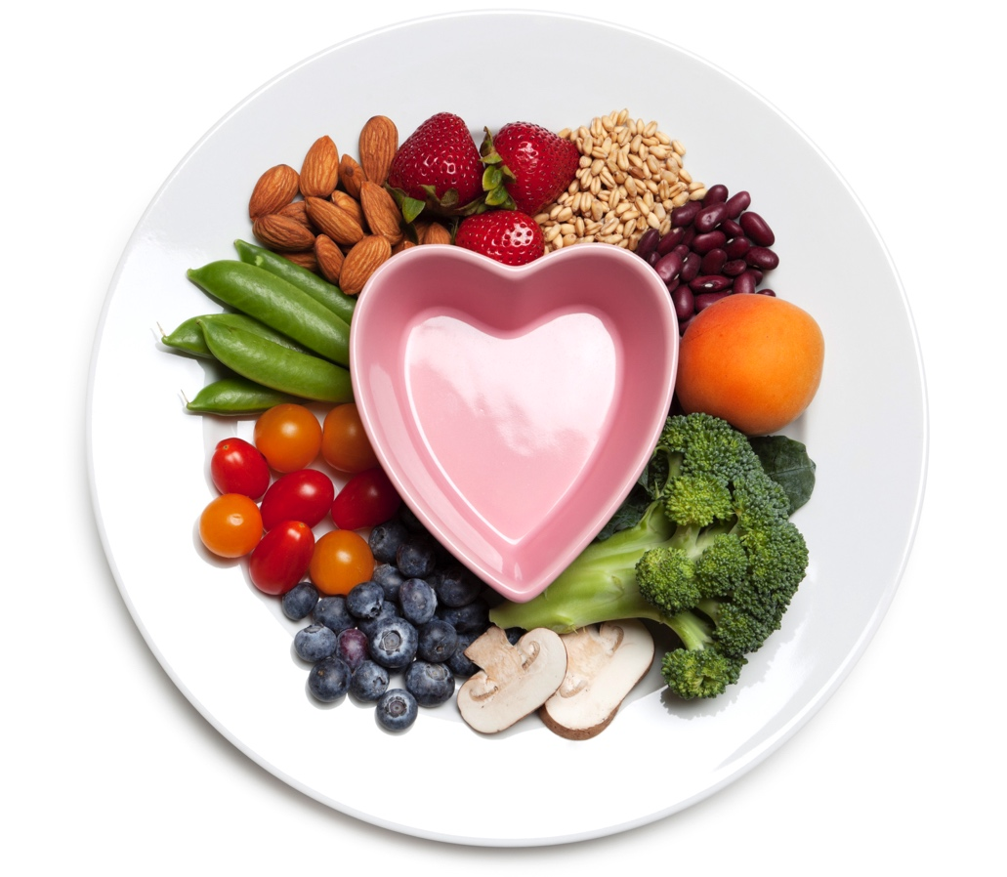
Eat more fruits, vegetables, and whole grains
Fill your plate with more fruits and vegetables
Choose whole grains like whole-grain pasta, whole-wheat bread, oatmeal
Notes:
Get most of your calories from natural, nutrient-dense foods like fruits, vegetables, and whole grains.
To do this:
Fill your plate with more vegetables and fruits, which are good sources of vitamins and minerals. They are also low in calories and high in fiber. Some fruits and vegetables have antioxidants, which are substances found in plants that may help prevent heart disease.
Choose whole grains to get more nutrients. Choose products like:
Whole-wheat flour, whole-grain bread, preferably 100% whole-wheat bread or 100% whole-grain bread
High-fiber cereal with 5 grams or more of fiber in a serving
Whole grains such as whole-grain pasta, barley and buckwheat (kasha), oatmeal (steel-cut, rolled oats or old-fashioned), or other grains like farro, or barley.
Avoid white, refined grains. For example: White refined flour, white bread, white pasta, or most treats like muffins, cakes, doughnuts, or quick breads.

Slide 43




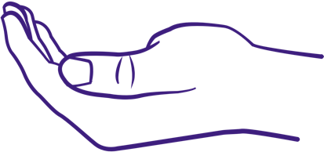
Control your serving sizes
Eat slowly (about 20 minutes) and stop when full
Check the nutrition label to find the serving size
Measure or estimate food for the correct serving size:
  1 teaspoon is about the size of the tip of your index finger
  3 ounces of lean meat is about the size of your palm
  1 tablespoon of oil is about the size of the top half of your thumb
  A small fist is 1 cup
  A cupped hand is ½ cup
Notes:
Another part of eating healthy is to control your serving sizes. Measure or estimate food to give yourself a single serving size.
To do this:
Eat slowly (take about 20 minutes) and stop eating when you are not hungry anymore. It takes about 20 minutes for your stomach to tell your brain that you are full, so the slower you eat, the more time your body will have to recognize that you are filling up.
Check nutrition labels to find the true serving size of a food. For example, a 20-ounce bottle of soda is really 2 ½ servings.
Sometimes it can be hard to be mindful of your portions when you do not have a measuring cup, spoon, or scale. There are some ways you can estimate the correct serving size. For example:
A small fist is 1 cup, which is a serving size for vegetables at a meal.
A cupped hand is ½ cup, which is good for measuring carbs like grains and fruits.
A 3-ounce serving of lean meat, like chicken, is about the size of the palm of your hand.
A tablespoon is about the size of the top half of your thumb.
A teaspoon is about the size of the tip of your index finger.

Slide 44

How to plan a kidney-friendly meal
Fill your plate with:
A ⅓ to ½ palm-sized serving of protein
Cupped hand of fruit
Cupped hand of bread or grains
Cupped hand of dairy
Fist-size of vegetables
½ thumb-size of healthy fat
Notes:
Although your plate will not always look like this picture, consider these portions for a kidney-friendly meal.
This meal of stir-fry shows servings of:
A ⅓ to ½ palm-sized portion of protein (pieces of lean cooked pork)
Cupped hand of fruit (sliced mango)
Cupped hand of bread or grains, such as brown rice, corn tortilla, or popcorn (steamed brown rice)
Cupped hand of dairy, such as low-fat milk or yogurt – missing from this one – could show another example that has dairy)
Fist size of vegetables (diced bell peppers, chopped scallions/green onions)
½ thumb-sized serving of healthy fat, such as olive oil or vegetable oil (point out this stir fry could be cooked using olive or canola oil)

Slide 45
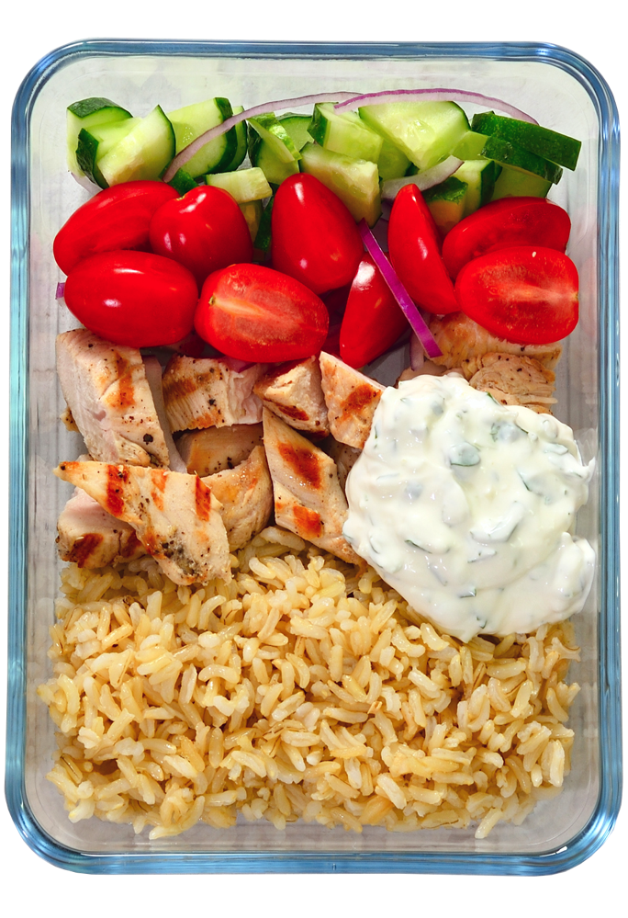
How to plan a kidney-friendly meal
Fill your plate with:
A ⅓ to ½ palm-sized serving of protein
Cupped hand of fruit
Cupped hand of bread or grains
Cupped hand of dairy
Fist-size of vegetables
½ thumb-size of healthy fat
Notes:
Although your plate will not always look like this picture, consider these portions for a kidney-friendly meal.
This meal shows servings of:
A ⅓ to ½ palm-sized portion of protein (chicken)
Cupped hand of fruit (tomato)
Cupped hand of bread or grains, such as brown rice
Cupped hand of dairy, such as low-fat milk or yogurt (yogurt-based dressing/sauce)
Fist size of vegetables (onion, cucumber)
½ thumb-sized serving of healthy fat, such as olive oil (chicken could be cooked in canola or olive oil, dressing could have olive oil)

Slide 46

Activity: What foods fit into each food group?
Name the:
Protein
Fruit
Bread or grains
Dairy
Vegetables
Healthy fat
Notes:
Now we will show some examples of kidney healthy plates. I want you to name which foods on the plate fit into each food group.
What foods on the plate are:
Proteins: Grilled chicken, kidney beans
Fruit: lemon to drizzle for flavor
Bread or grains: quinoa
Dairy: missing; could have a glass of milk with it or sprinkle cheese on top
Vegetables: Brussels sprouts, broccoli, spinach, green pepper
Healthy fat: olive oil dressing

Slide 47


Kidney Kitchen®
kitchen.kidneyfund.org
Notes:
Kidney Kitchen is the American Kidney Fund’s nutrition-focused website that provides information on the basics of healthy eating and cooking with kidney disease.
Kidney Kitchen offers information and resources on what people living with kidney disease can eat and drink and empowers people to make positive food and fluid choices without feeling burdened or discouraged.
To learn more about Kidney Kitchen, visit: https://kitchen.kidneyfund.org/

Slide 48





Be active
Being active can help control blood pressure and diabetes and keep a healthy weight
Set a goal to be active for 30 minutes a day, 5 days per week
Start slowly – add an extra activity into your routine, such as a walk after a meal
Find activities you enjoy, like walking, dancing, gardening, or playing a sport
Notes:
Being active in a safe area is important for your overall health. It is also helpful to prevent diabetes, high blood pressure, and CKD.
Aim to be active for 30 minutes a day, 5 days a week. Being active does not have to be boring or happen all at one time during the day. It is helpful to start slowly. For example, add an extra activity into your routine, such as a walk after a meal, or taking the stairs instead of the elevator. Find activities that you enjoy, like walking, dancing, gardening, or playing a sport. If you cannot walk up all the flights of stairs, try walking 1 to 3 flights and then taking the elevator the rest of the way.
Remember, it is important to talk to your doctor before starting a new exercise routine.

Slide 49



Other ways to prevent CKD
Quit smoking
Limit alcohol
Talk with your doctor
Notes:
There are other changes you can make to lower your chance of getting CKD.
First, if you smoke, quit. Smoking, or even chewing tobacco can raise blood pressure and damage the kidneys. Free resources like smokefree.gov or 1-800-QUIT-NOW can help.
Limit alcohol. In general, women should have no more than 1 drink per day and men should have no more than 2 drinks per day (this is based on a person’s body size). Too much drinking can increase blood pressure, which then can damage the kidneys.
Talk with your doctor about ways to prevent CKD. It is always better to catch health problems early before they get worse.

Slide 50
Write down 3 things you’ll do to prevent CKD
Take steps to manage my diabetes
Take steps to control my high blood pressure
Make this change to eat healthy
Take steps to be more active
Other
Notes:
Now that we have talked about ways to prevent CKD, take a moment to write down 3 things you will do to prevent CKD.
The slide has some general examples. Try to make your action steps as specific as possible.

Slide 51
4
Treatments for kidney failure
Notes:
Remember, once a person reaches kidney failure, their kidneys will not get better. There is no cure for kidney failure. But many people live long lives with treatment.
The main treatments for kidney failure are dialysis, kidney transplant, and medical management.

Slide 52



Main treatments for kidney failure
Dialysis
Kidney transplant
Medical management
Notes:
There are 3 main treatment types for CKD. Let’s talk about each of them.

Slide 53

What is dialysis?
A treatment to clean the blood when the kidneys are not able to
It does some of the work that the kidneys did when they were healthy – but it can only do 10-15% of what a normal kidney does
There are 2 types:
10-15%
Hemodialysis
(HD)
Peritoneal dialysis (PD)
Notes:
Dialysis is a treatment to clean your blood when your kidneys are not able to. Dialysis does not make the kidneys better; it replaces the job healthy kidneys would normally do. But dialysis only does some of the work that healthy kidneys do—about 10 to 15 percent of what a normal kidney does.
There are 2 types: hemodialysis and peritoneal dialysis, or PD for short.

Slide 54
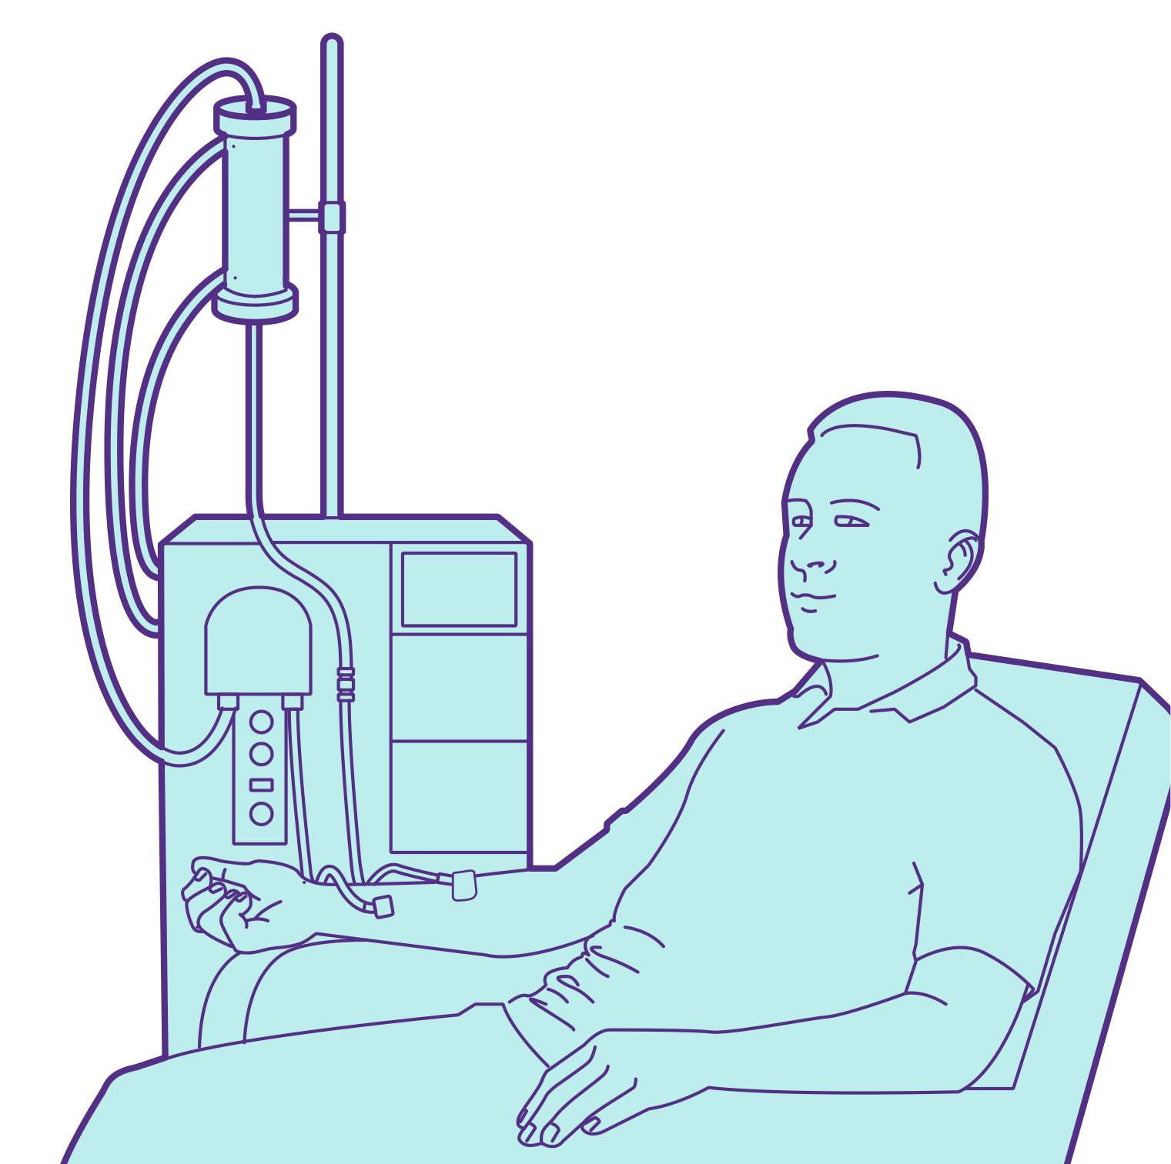
Hemodialysis
Dialyzer: a filter that cleans your blood by removing some of the waste and extra fluid
Uses a machine to clean your blood
Can be done in a dialysis center or at home, during the day or at night
In-center treatments usually happen 3 days per week, for about 4 hours each time
Tube that carries cleaned blood back to your body
Hemodialysis machine
Needle in your arm connects to a tube that carries blood from your body into the machine
Notes:
Hemodialysis uses a machine to clean your blood. Blood travels from a needle, usually in your arm (a special port is created for access), through a tube and into a machine that cleans it. Clean blood goes back into your body through another tube and needle.
You can do hemodialysis at a dialysis center, or at home. When done in-center, it is usually done 3 times per week, for about 4 hours each session.

Slide 55
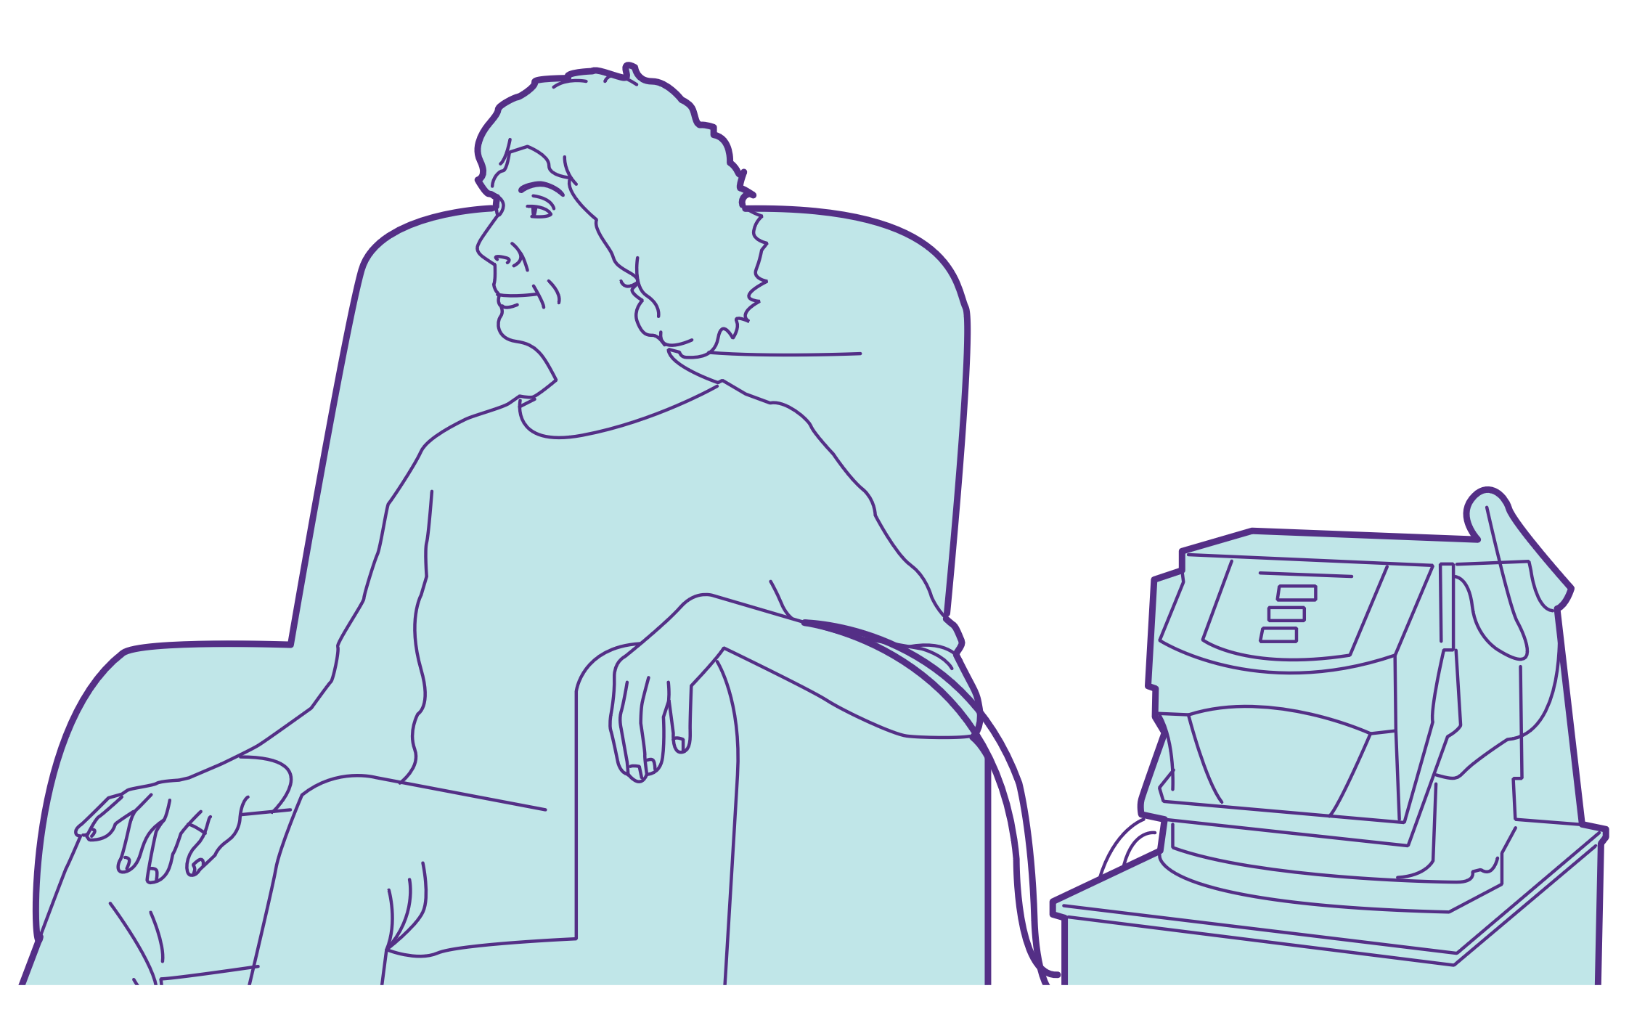
Home hemodialysis
Usually happens 6 days per week, for about 2-3 hours each time
On home hemodialysis, you:
  May be able to be less strict with your meal plan if you do treatments everyday
  Don’t need to travel to a center and may have more flexibility in your schedule
  Can keep working
  Can travel if you plan for it
Notes:
If done at home, hemodialysis is usually done 6 days a week and takes 2 to 3 hours each time. You will need training on how to do your treatment and some support at home.
There are some benefits to home hemodialysis:
If you do your treatments everyday, you may be able to be less strict with your meal plan
Since you don’t have to travel to a center, you may have more flexibility in your schedule
You can keep working
And, you can travel if you plan for it by bringing your machine with you on your trip

Slide 56
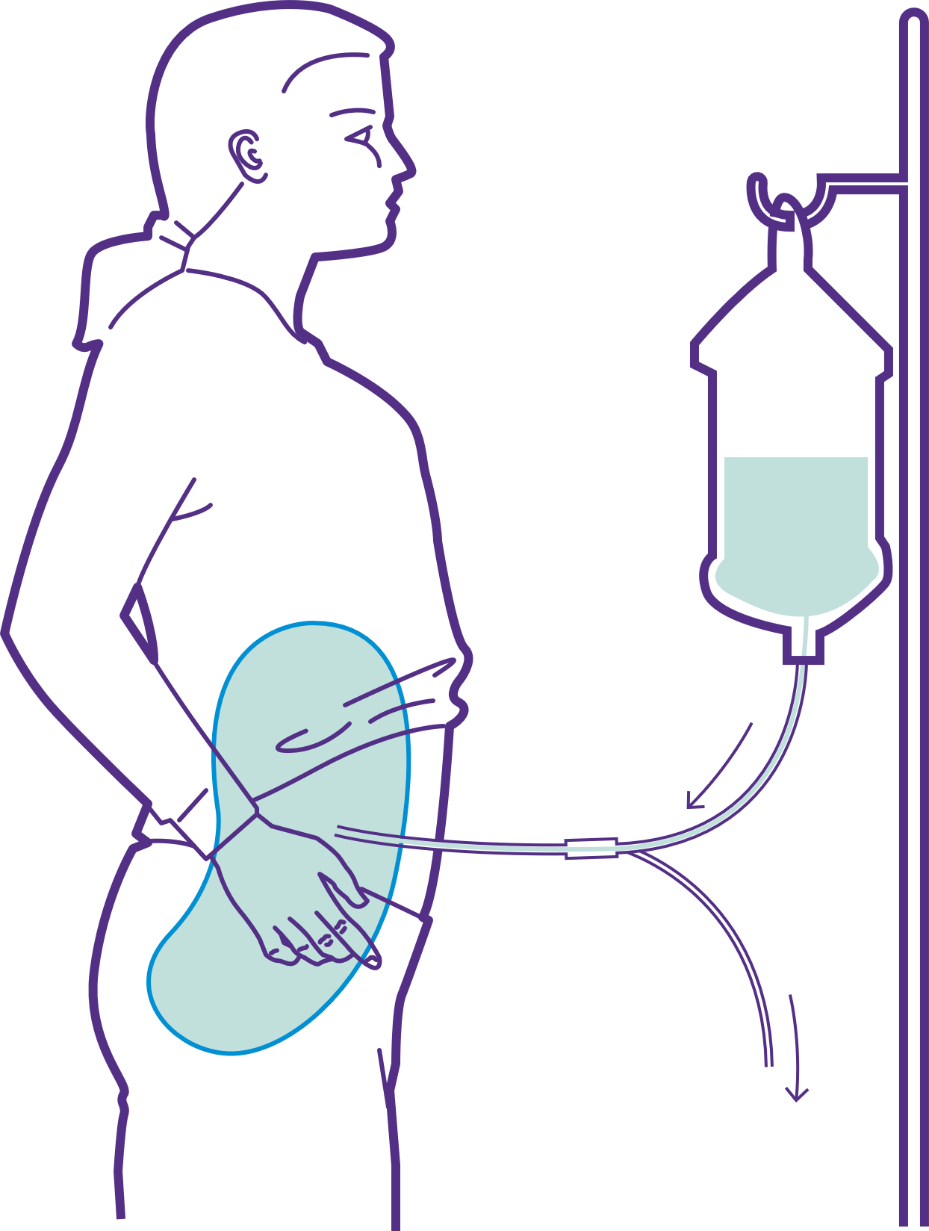
Peritoneal dialysis (PD)
Dialysis solution
Uses a fluid that is put in your belly and then removed to clean your blood
Can be done in any clean, dry place
Can be done at home, work, or school
Done continuously throughout the day and night
Catheter
Space inside the belly
Lining of the belly
Tube to drain bag
Notes:
Peritoneal dialysis (or PD) uses a fluid that is put into your belly and then removed to clean your blood. During PD, you fill an area of your belly with a cleaning fluid called dialysate. The dialysate uses the lining that covers most of the organs in your belly, called the peritoneum, to serve as a filter for the dialysis process.
You have to let the dialysate sit in your belly for a period of time while it cleans your blood. The amount of time depends on the person. Then, you will drain the used dialysate out of your belly and refill your belly with fresh dialysate. This process of draining used dialysate and refilling with fresh dialysate is called an exchange.
Peritoneal dialysis can be done anywhere that is clean and dry, which means you may be able to keep working or going to school with this treatment option. It is done continuously throughout the day or night. People usually complete 4 to 6 exchanges every 24 hours.

Slide 57

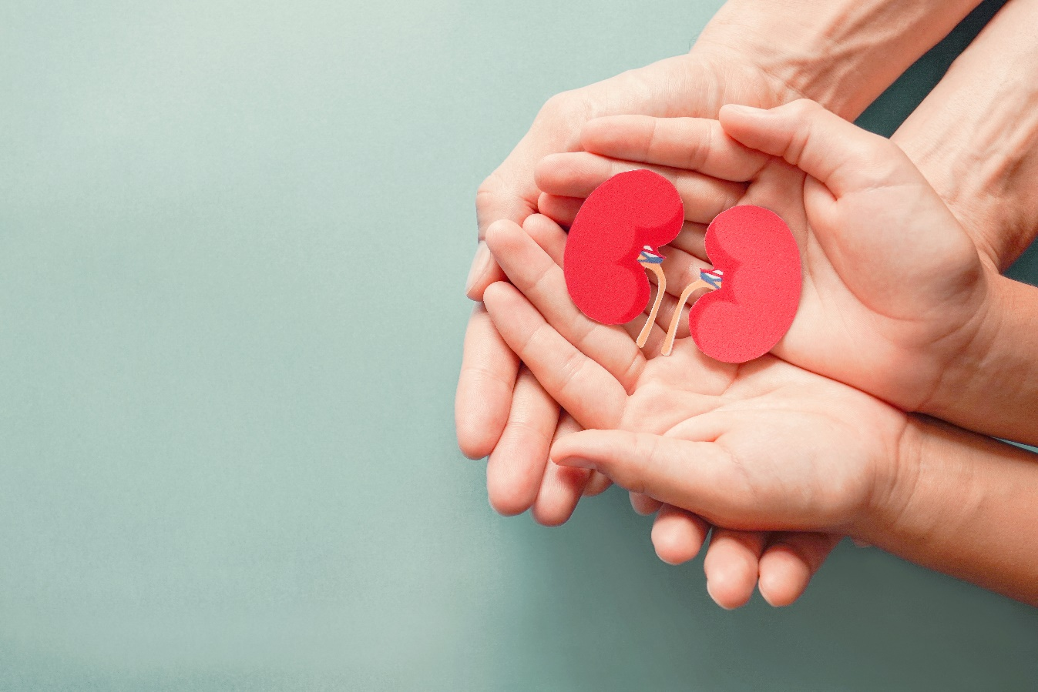
Kidney transplant
A surgery where doctors put a healthy kidney from someone else into a person with kidney failure
The best treatment option because it raises chances of living a longer, healthier life
After a kidney transplant, you must take immunosuppressant medicines for as long as the transplant lasts
Notes:
Kidney transplant is considered the best treatment option for people facing kidney failure because it can raise your chances of living a longer, healthier life. People with successful kidney transplants can stop dialysis for as long as their kidney transplant lasts.
To get a kidney transplant, you must first be evaluated by a transplant team. The team includes doctors, nurses, social workers, and dietitians. They will look at your physical and mental health, as well as your financials, because caring for a new kidney takes a lot of work.
After a kidney transplant, you must take immunosuppressant medicines, also known as anti-rejection medicines, for as long as the transplant lasts. These medicines prevent your body from rejecting (fighting) the new kidney. This can happen if your body’s immune system realizes that the kidney is from someone else. Immunosuppressant medicines lower (suppress) your immune system to weaken its response to fight your new kidney.

Slide 58
Types of transplants
 | Living donor transplant | Living donor: Paired kidney donation | Deceased donor transplant
What is it? | Healthy kidney comes from someone who is living | 2 or more pairs of kidney patients and their donors swap donors, so each patient gets a kidney that works for them | Healthy kidney comes from someone who has just died
How long does the transplanted kidney last? | 15-20 years | 15-20 years | 10-15 years
Notes:
There are different types of kidney transplants. Transplanted kidneys can be from a donor who is alive, or from a donor who has recently died.
A living donor kidney transplant is a surgery where the healthy kidney comes from someone who is living, also called a living donor. This is possible because each person only needs one healthy kidney to live. A person with two healthy kidneys can donate one kidney to a person with kidney failure. A living donor can be a family member, friend, or even a stranger!
Paired kidney donation (or paired exchange) is a type of living donor transplant. It is an option when a kidney patient has a relative or friend who is willing and able to be a kidney donor, but they are not a match. The donor gives their kidney to a second patient who needs it, and that second patient’s relative or friend gives their kidney to the first patient. Paired kidney exchange can happen with 2 or more pairs of kidney patients and their donors. Each patient swaps their donor so that both patients get a kidney that works for them.
A deceased donor is when a healthy kidney comes from someone who has just died, also called a decease donor. This person or their family member decided to donate healthy organs at the time of death to help people who need transplants. No matter how the person died, their kidney is only transplanted if it is healthy and matches with the kidney patient.
Research has shown that people who get a kidney from a living donor live longer than people who get a kidney from a deceased donor. On average, living kidney donor transplants last 15 to 20 years, and deceased kidney donor transplants last 10 to 15 years. The amount of time that a transplanted kidney lasts is also based on having no complications.
Kidney transplant surgery is considered safe and is usually very successful. A successful kidney transplant depends on how healthy you are before the transplant, taking care of yourself after your transplant, and closely following your doctor’s orders after the transplant.

Slide 59

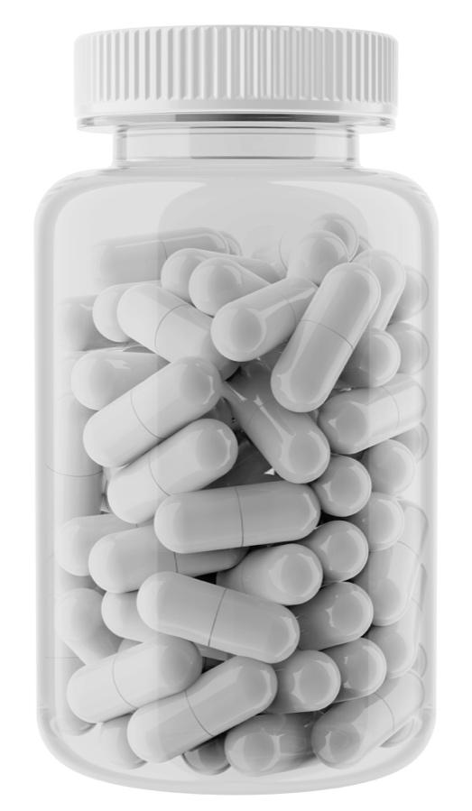
Medical management
Also called supportive care or comfort care
Uses medicines to treat the symptoms of kidney failure without dialysis or a kidney transplant
Can help you live comfortably, but it will not keep you alive
More common among older people and people with 2 or more illnesses at the same time
Notes:
Certain patients may opt for medical management, also called supportive care or comfort care. Supportive care uses medicines to treat the symptoms of kidney failure without doing dialysis or having a kidney transplant. It can help a person live comfortably, but it will not keep them alive.
This option is more common among older people and people dealing with two or more illnesses at the same time. The goal is to keep the person comfortable, but lengthening their life is not necessarily realistic. How long you will live depends on many things. Every person is different, and nobody can give you a definite answer to this question.
When choosing a treatment option, it is important to consider the pros and cons of each type. You can also discuss it with your doctor and loved ones.

Slide 60
Activity: Match the treatment to its description
Medical management
A
  Surgery to get a healthy kidney
Type letter
Dialysis
B
A treatment that cleans your blood
Type letter
  Kidney transplant
C
Treats the symptoms of kidney failure
Type letter
Notes:
Now you can show what you have learned! Match the treatment to its description.
[Let participants talk, then show all the answers]

Slide 61
Answer: Match the treatment to its description
Medical management
C
Treats the symptoms of kidney failure
Dialysis
B
A treatment that cleans your blood
  Kidney transplant
A
  Surgery to get a healthy kidney
Notes:
Here’s the answers.
[Let participants talk, then show all the answers]

Slide 62
Activity: Summary
When your kidneys are permanently damaged and do not work as well as they should, it is called chronic kidney disease (CKD)
The most common causes of CKD are diabetes and high blood pressure
Symptoms of CKD usually do not appear until later stages or kidney failure
Ask your doctor about tests for kidney disease. This is the only way to know how well your kidneys are working.
You can prevent CKD and kidney failure by:
Notes:
Now w have come to the end of our kidney education section. Let’s recap the most important points to remember going forward. These are the most important messages you will want to walk away with. Please shout out the answer to fill in the blank. Click to next slide to reveal answers.
[Answers]
When the kidneys are permanently damaged and do not work as well as they should, it is called chronic kidney disease (CKD).
The most common causes of CKD are diabetes and high blood pressure.
Symptoms of CKD usually do not appear until later stages or kidney failure
Ask your doctor about blood or urine tests. This is the only way to know how well your kidneys are working.
You can prevent CKD and kidney failure by:
Controlling diabetes and high blood pressure
Eating healthy
Being active

Slide 63
Answer: Summary
When your kidneys are permanently damaged and do not work as well as they should, it is called chronic kidney disease (CKD)
The most common causes of CKD are diabetes and high blood pressure
Symptoms of CKD usually do not appear until later stages or kidney failure
Ask your doctor about tests for kidney disease. This is the only way to know how well your kidneys are working.
You can prevent CKD and kidney failure by:
Controlling diabetes and high blood pressure
Eating healthy
Being active
Notes:
[Answers]
When the kidneys are permanently damaged and do not work as well as they should, it is called chronic kidney disease (CKD).
The most common causes of CKD are diabetes and high blood pressure.
Symptoms of CKD usually do not appear until later stages or kidney failure
Ask your doctor about blood or urine tests. This is the only way to know how well your kidneys are working.
You can prevent CKD and kidney failure by:
Controlling diabetes and high blood pressure
Eating healthy
Being active

Slide 64
References
American Diabetes Association. (2020). Diagnosis. Retrieved from https://www.diabetes.org/a1c/diagnosis
American Kidney Fund. (n.d.). Retrieved from www.kidneyfund.org
Centers for Disease Control and Prevention (CDC). (2020). Chronic Kidney Disease Basics. Retrieved from https://www.cdc.gov/kidneydisease/basics.html
Centers for Disease Control and Prevention. (2021). Facts About Hypertension. Retrieved from https://www.cdc.gov/bloodpressure/facts.htm
Food and Drug Administration (FDA). (2020). Sodium in your diet, use the nutrition facts label and reduce your intake. Retrieved from https://www.fda.gov/food/nutrition-education-resources-materials/sodium-your-diet
Harvard T.H. Chan School of Public Health. (2011). The Nutrition Source. Healthy Eating Plate. Retrieved from https://www.hsph.harvard.edu/nutritionsource/healthy-eating-plate/
National Kidney Foundation. (2020). ACR. Retrieved from https://www.kidney.org/kidneydisease/siemens_hcp_acr
National Kidney Foundation. (2020). Three simple tests your should ask your doctor to do. Retrieved from https://www.kidney.org/news/kidneyCare/Spring09/askYourDoc_spring09#:~:text=Ask%20your%20doctor%20about%20these,keep%20it%20from%20getting%20worse!
Notes:
Here are the list of references for this presentation.

Slide 65
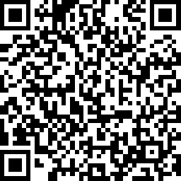
Thank you!
Please take a moment and complete our quiz and evaluation form.
https://www.surveymonkey.com/r/KHCSessionSurvey
Notes:
Thank you for participating in this education session today. I hope you have learned more about kidney disease. I now have time to take any questions!
I will then provide the link for you to take the quiz and post-evaluation. Your responses will help the American Kidney Fund improve the program.
[Ensure the audience can access the link and complete the quiz and post-evaluation before they leave]

