Slide 1
Be APOL1 aware and learn if you may be at risk

Slide 2
Today we will discuss
What is APOL1 and how does it cause kidney disease?
Who is at risk?
How do you know if you have APOL1 genetic mutations?
What steps can you take to prevent kidney disease, if you have APOL1 gene mutations?

Slide 3
USDA Food Safety & Inspection Service
USDA Food Safety & Inspection Service
USDA Food Safety & Inspection Service
What is APOL1?

Slide 4
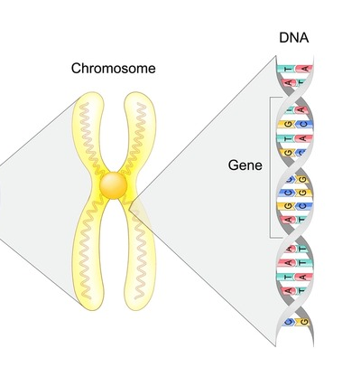
What is APOL1?
APOL1-mediated kidney disease (AMKD) is a genetic condition associated with mutations in the apolipoprotein L1 (APOL1) gene.
Everyone has two APOL1 genes. The APOL1 gene makes protein in your immune system.
Some people are born with mutations (a change) in one or both APOL1 genes.
If you inherit mutations in both APOL1 genes you have an increased risk for developing kidney disease and even kidney failure.

Slide 5
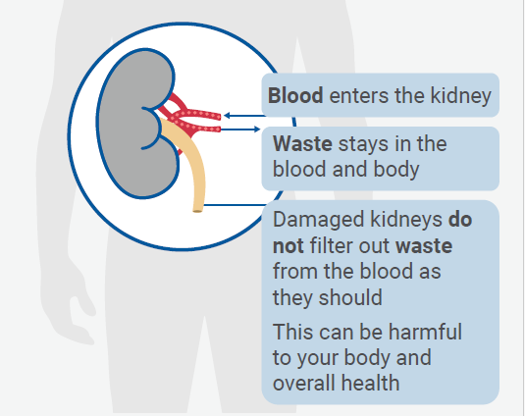
How does APOL1 cause kidney disease?
APOL1 mutations can:
  Cause damage to parts of the kidney that filter blood
  Cause cells in the kidney to die, which leads to damage and scarring in the kidneys, leading to kidney failure
If you have APOL1 mutations, you have a 10 times higher chance of having a focal segmental glomerulosclerosis (FSGS).
  FSGS: a rare type of kidney disease that causes scarring (sclerosis) in the filters of your kidneys. This makes it harder for the kidneys to filter waste.

Slide 6
USDA Food Safety & Inspection Service
USDA Food Safety & Inspection Service
USDA Food Safety & Inspection Service
Who is at risk?

Slide 7

Who is more likely to have a mutation in the APOL1 gene?
You are more likely to have APOL1 gene mutations if you are from Western or Central African descent. This includes people who identify as Black, African American, Afro-Caribbean and Latina/Latino.
The APOL1 gene evolved over thousands of years in people who lived in Western and Central Africa. It is associated with protection against a certain type of parasite that causes African sleeping sickness.
If you have mutations in both copies of the APOL1 gene, there is a 1 in 5 chance that you will develop kidney disease.

Slide 8
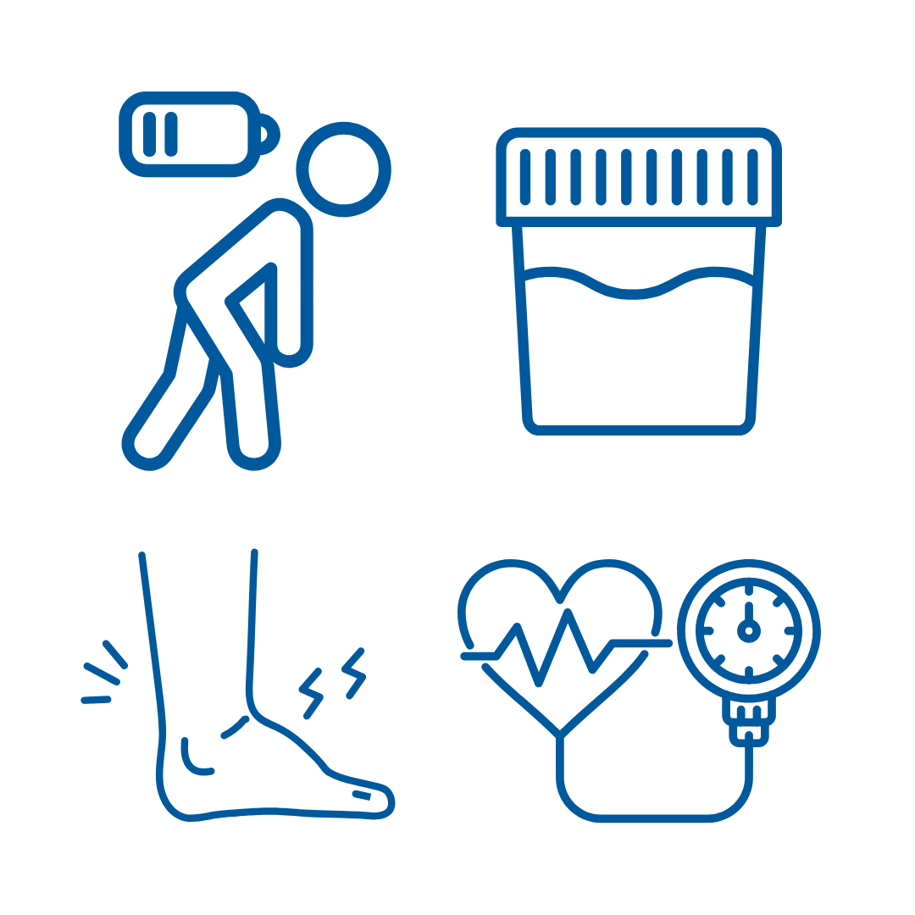
What are the symptoms of kidney disease?
If you have APOL1 gene mutations that cause damage to your kidneys, you may not have symptoms of kidney disease until your kidneys are close to failing.
As kidney damage gets worse, you may notice:
  Protein in your urine (pee)
  Swelling in your legs or weight gain
  Feeling weak and tired
  High blood pressure
Talk to your doctor about getting tested for kidney disease if you have these symptoms or have family members who have kidney disease.

Slide 9
USDA Food Safety & Inspection Service
USDA Food Safety & Inspection Service
USDA Food Safety & Inspection Service
How do you know if you have APOL1 gene mutations?

Slide 10

Genetic testing
The only way to know if you have the APOL1 gene mutations is to do genetic testing. This test takes a sample of blood or saliva (spit) to look for gene mutations.
If you are interested in doing a genetic test, talk to your doctor.
Your doctor may consider genetic testing if you:
  Have kidney disease and do not know the cause
  Are considering donating a kidney
  Know a family member is a carrier for the APOL1 gene mutation
Notes:
If you have the APOL1 gene mutations, your family members may also have the gene mutations. You may want to talk with your family members about speaking with their doctor about options for genetic testing.

Slide 11

Genetic counselors
Your doctor can order the genetic test or refer you to a genetic counselor.
Genetic counselors are health care professionals with specific training in genetics and counseling.
Some genetic testing companies may offer low-cost or no-cost options for those eligible.

Slide 12
USDA Food Safety & Inspection Service
USDA Food Safety & Inspection Service
USDA Food Safety & Inspection Service
What steps can you take to prevent kidney disease?

Slide 13

Prevent or delay progression of kidney disease
Kidney disease caused by APOL1 gene mutations (AMKD) progresses much faster than other kidney diseases.
You are also more likely to progress to kidney failure much faster than if you do not have AMKD.
Steps you can take to protect your kidneys:
  Visit your doctor regularly to check your blood and urine levels and overall health
  Follow a healthy eating plan
  Take all your prescription medicines as your doctor tells you
  Be active at least 30 minutes a day most days of the week
  Quit smoking or using tobacco

Slide 14

Clinical trials
There is currently no cure for AMKD. But if you know you have the disease you may be able to participate in a clinical trial.
Clinical trials are research studies that study the effectiveness of new treatments.
This could provide an opportunity for researchers to develop and test safe treatments for AMKD.
Learn more and find a clinical trial: kidneyfund.org/kidney-health-for-all/clinical-trials

Slide 15
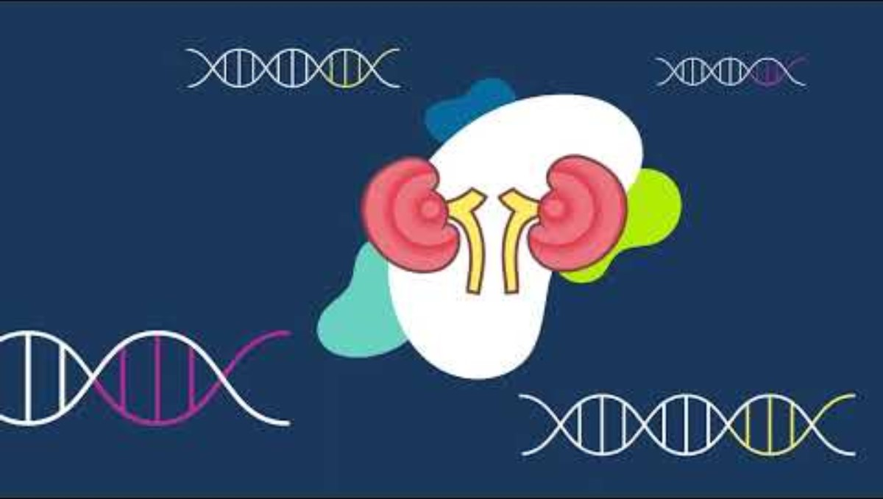
Watch: APOL1-mediated kidney disease (English)
Notes:
Watch and share the YouTube video: https://www.youtube.com/watch?v=aIBF4qaRLV0
Subtitles are available in Spanish

Slide 16

Be APOL1 Aware
April 29, 2025 is National AMKD Awareness Day
KidneyFund.org/APOL1Aware​

Slide 17

Resources
Visit KidneyFund.org/APOL1Aware or scan this QR code with your smartphone to learn more
National AMKD Awareness Day
Notes:
For more resources on AMKD, please visit kidneyfund.org/apol1aware or scan these QR codes with your smartphone to learn more.

Slide 18

Thank you!
Please take a moment to complete the evaluation
Scan this QR code with your phone:
www.surveymonkey.com/r/AMKD-KHC
Notes:
Thank you for participating in this AMKD session. I hope you have learned more about kidney disease. I now have time to take any questions!
I will then provide the link for you to take the quiz and post-evaluation. Your responses will help the American Kidney Fund improve the program.
Survey link: www.surveymonkey.com/r/AMKD-KHC

